Slide 1
University of Waterloo API Architecture and Implementation Powering Student and Institutional Innovation
Colin Bell Director Enterprise Architecture
EA, IST
BMath
2008
uwat.ca/ist-ea
Zachary Seguin Open Data API Incoming Dev Lead
Client Services, IST
BCS Computer Science
2017
uwaterloo.ca/open-data
Kartik Talwar Open Data API Outgoing Dev Lead
Client Services, IST
BSc Physics
2016
uwaterloo.ca/open-data
Nate Vexler Open Data API Service Lead
Client Services, IST
BASc Systems Design Eng.
2012
uwaterloo.ca/open-data

Slide 2
Agenda
Background
Prime Motivators
Routine Disclosure
Why Open Data First?
5 Star Data
Open Data License
History of Open Data
Technical Specifics
Data Sets
Data Acquisition
Technology

Slide 3
Agenda
Growing
Governance and Policy
Private Data (PbD)
Business Process
Data Warehousing/ESB/iPaaS
Future Directions
Questions
Buy vs. Build?
How to build today?
Documentation?
How do you deal with the ERP culture clash?

Slide 4
BACKGROUND

Slide 5
Original Prime Motivators
Enable Student Development
Enable Homebrew Student Portal

Slide 6
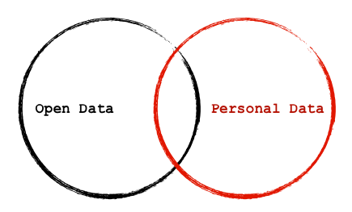
Protecting Privacy
http://eaves.ca/2013/01/07/the-journal-news-gun-map-open-vs-personal-data/

Slide 7


Maintaining Transparency Protecting Privacy
bit.ly/ipc_abd
bit.ly/ipc_pbd

Slide 8
Routine Disclosure
Policy of Ontario’s Information Privacy Commissioner
7 principles
bit.ly/ipc_abd

Slide 9
Routine Disclosure
Proactive, not Reactive
Access Embedded into Design
Openness and Transparency = Accountability
Fosters Collaboration
Enhances Efficient Government
Makes Access Truly Accessible
Increases Quality of Information

Slide 10
WHY Open Data First?
Personally Identifiable Data
Notes:
Open Data does NOT include Personally Identifiable Data

Slide 11
WHY OPEN DATA First?
bit.ly/ipc_abd
Notes:
Routine disclosure
Open Data
Access By Design

Slide 12
WHY Open Data First?
Emerging trend in Government (Toronto, Vancouver)
New Vertical (Higher Ed)
Notes:
It was the classic Canadian maneuver. Do something that has already been done in another vertical here in Canada and jump on the train. (It very difficult to start a trend from scratch).

Slide 13
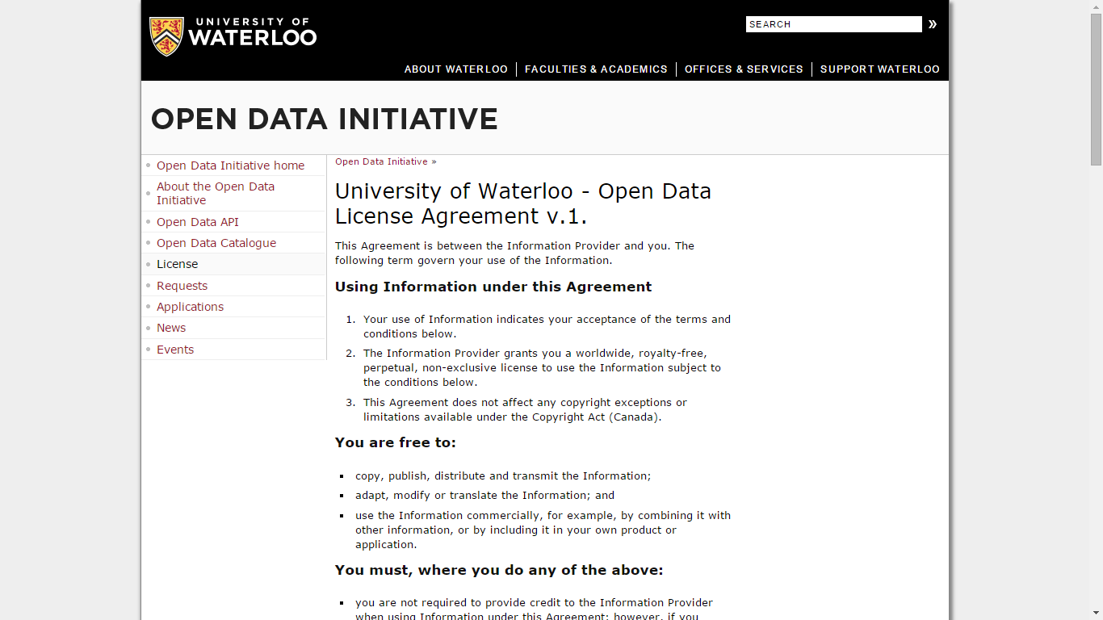
Open Data License

Slide 14
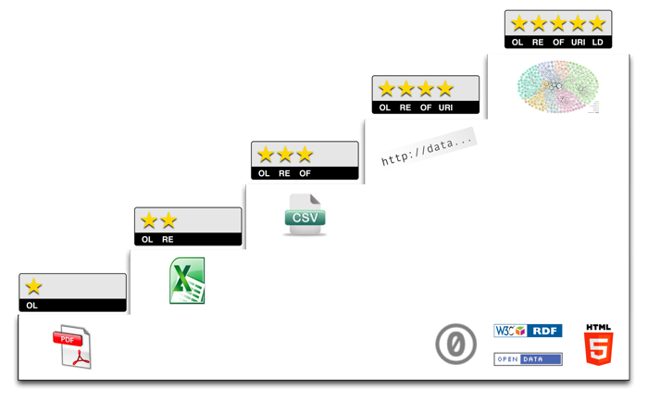
Open Data
5stardata.info
Notes:
Open Data comes in a spectrum
★ Open License (OL): make your stuff available on the Web (whatever format) under an open license. Most importantly, to get any star at all, the data must be licensed to be explicitly as Open.
★★ (Machine) Readable (RE): make it available as structured data (e.g., Excel instead of image scan of a table).
★★★ Open Formats: use non-proprietary formats (e.g., CSV instead of Excel).
★★★★ Uniform Resource Identifier (URI): use URIs to denote things, so that people can point at your stuff.
★★★★★ Linked Data (LD): link your data to other data to provide context. From <http://5stardata.info/>
Open Data is about releasing human-targeted information in ways that are increasingly easier and more efficient to manipulate by 3rd parties.

Slide 15
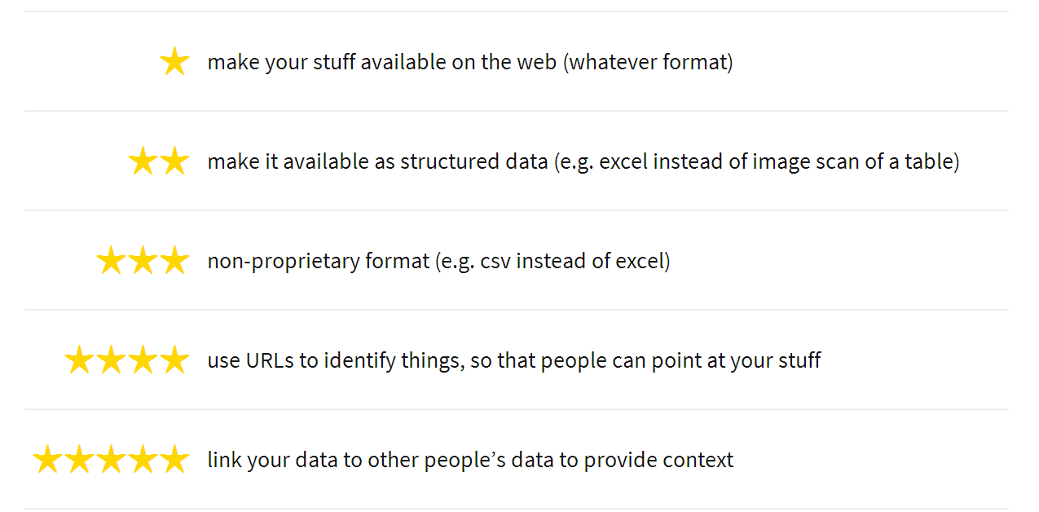
Improving Open Data
inkdroid.org/journal/2010/06/04/the-5-stars-of-open-linked-data/

Slide 16
Why Is Open Data Important
Economies of Scale
Value of Data
Cost of Using Data
Notes:
The Data economy is about taking something with an initial value and driving a whole value chain around it so that it amplifies utility gained many fold. The utility Is gained though
Increased Economies of scale. For example data which is usually disclosed on a piece meal basis can now be intentionally routinely disclosed.
Increased value of data. While the originators of data are once uniquely positioned to amplify the reach and impact of their data, with routinely disclosed data, the network of people within the institutions and other related institutions can become many-fold force multipliers resulting in economic benefit.

Slide 17
Why Is Open Data Important
DO MORE
W/ LESS
Notes:
Quite simply, Open Data allows for the network around the data purveyors to do more with less.

Slide 18
Fall 2009
Nathan lobbies with others at Student Technology Advisory Committee re Portal/Open Data
March 2010
Presentation at High Level Computing Committees UCIST/CTSC
Fall 2010
Jeff Verkoeyen’s uwdata.ca becomes official
Aug 2011
Kartik Talwar creates api.youwaterloo.ca
Feb 2012
api.uwaterloo.ca becomes official
Open Data @ uwaterloo Timeline

Slide 19
2012
Nathan Joins IST full time
2013
V2 launches
2014
Open Data-powered Student Portal launches;
2015
Campus Map Project (powered by Open Data) is in development
Drupal-Powered Content Management System is leveraged to deliver Open Data for use in Student Portal
Student Portal project continues to further the momentum of Open Data
Open-Data powered apps:
- Student Portal (internal)
- uwflow.com (external)
mandate to bring api.uwaterloo.ca deeper into the enterprise
Open Data @ uwaterloo Timeline

Slide 20
IPC Core Design Principles
bit.ly/ipc_abd
bit.ly/ipc_pbd

Slide 21
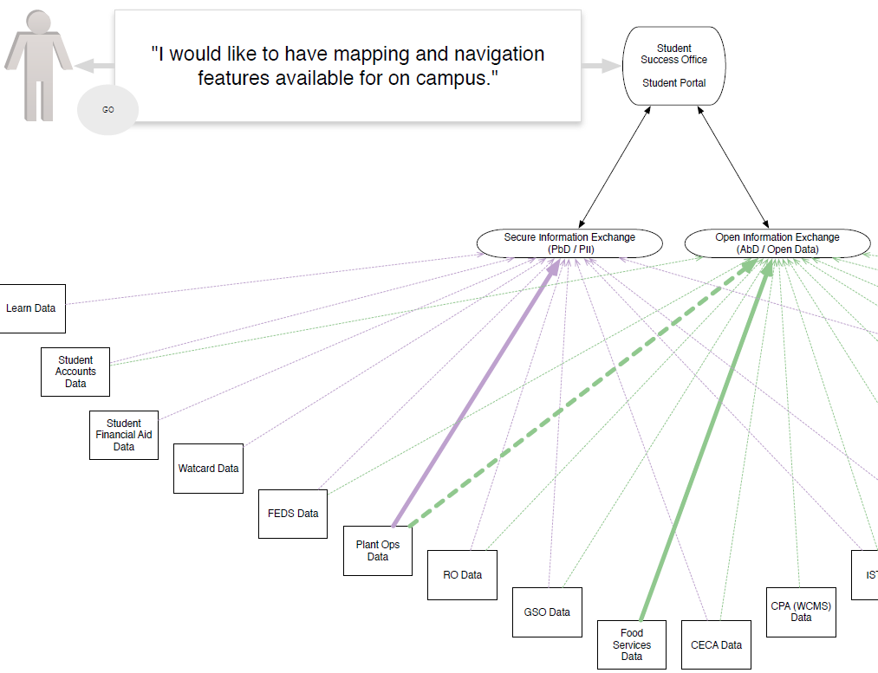
Student Portal AbD/PbD Strategy (Colin Bell)
Notes:
Open Data can be mashed up with private data to make service-based tools such as the Student Portal

Slide 22
Improving Open Data
inkdroid.org/journal/2010/06/04/the-5-stars-of-open-linked-data/

Slide 23
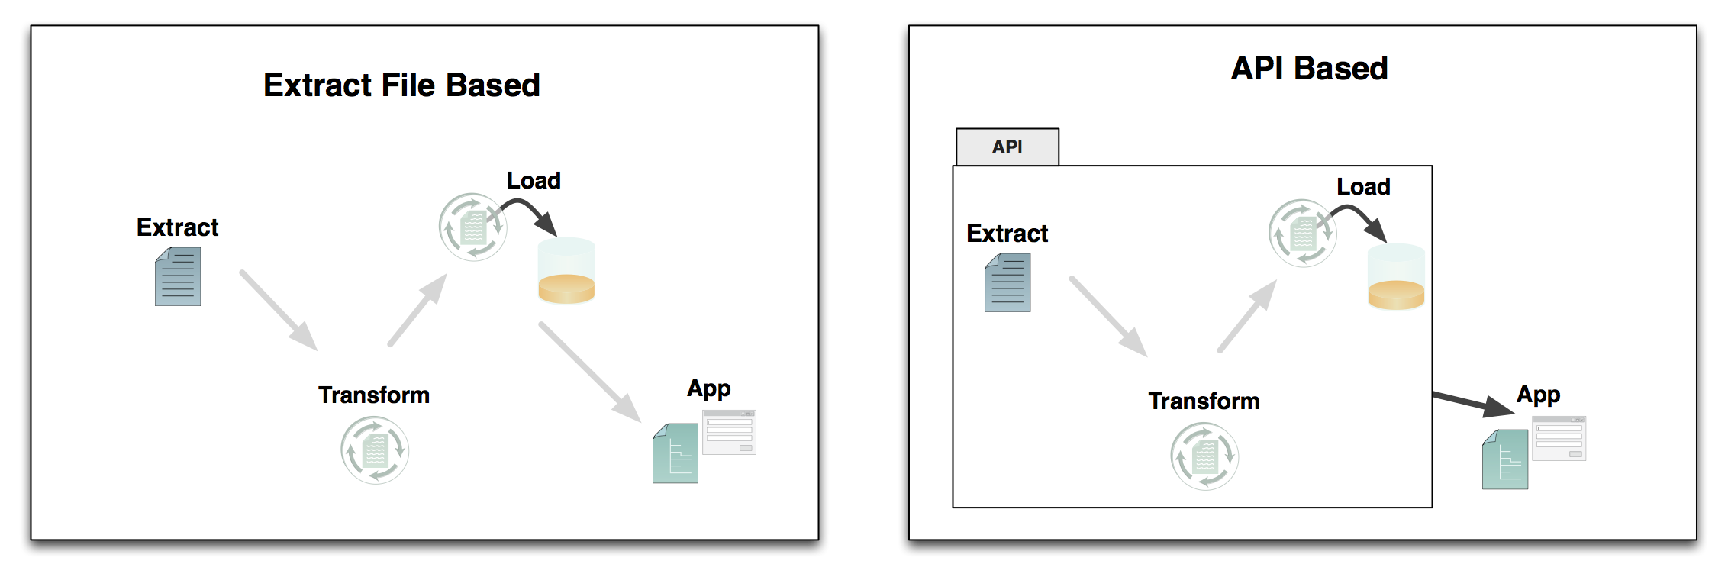
API: Application Programming Interface

Slide 24
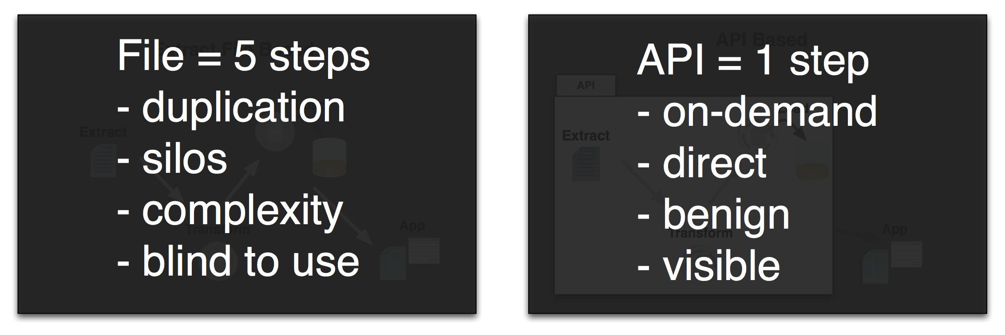
API: Application Programming Interface
Notes:
Do the ETL work once, do it well.
Reduce duplication of efforts.
Cut down on costs because it comes in a ‘usable’ form.
Referential links are moved around as URIs. (context)
Access can be monitored and controlled.

Slide 25
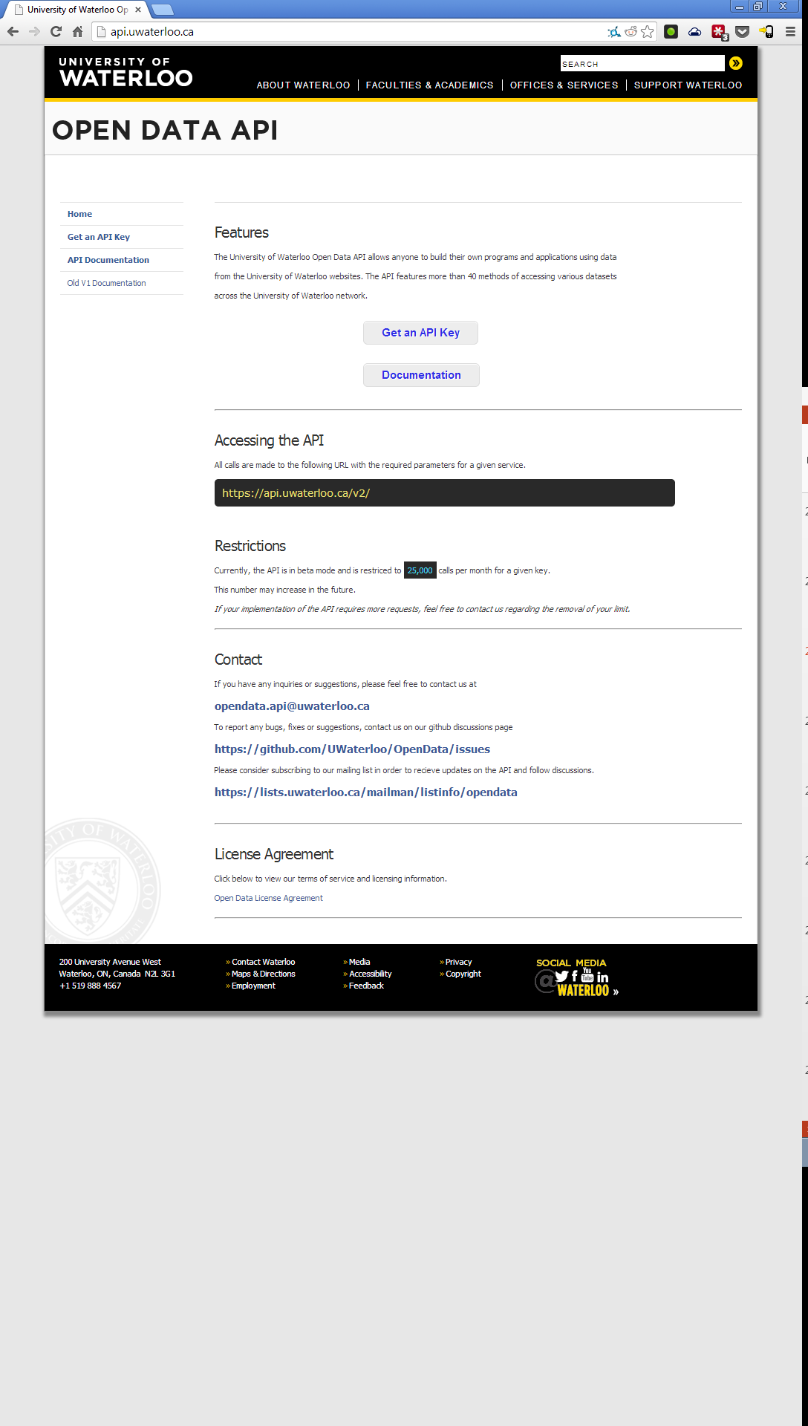

Slide 26
Core Areas Of Service of Current API
Student Engagement (Portal)
Core IT Service (WCMS)
Emerging Academic Use
For Students by Students
Open Data API

Slide 27
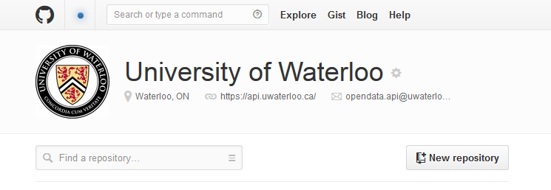
uWaterloo GitHub
github.com/uwaterloo

Slide 28
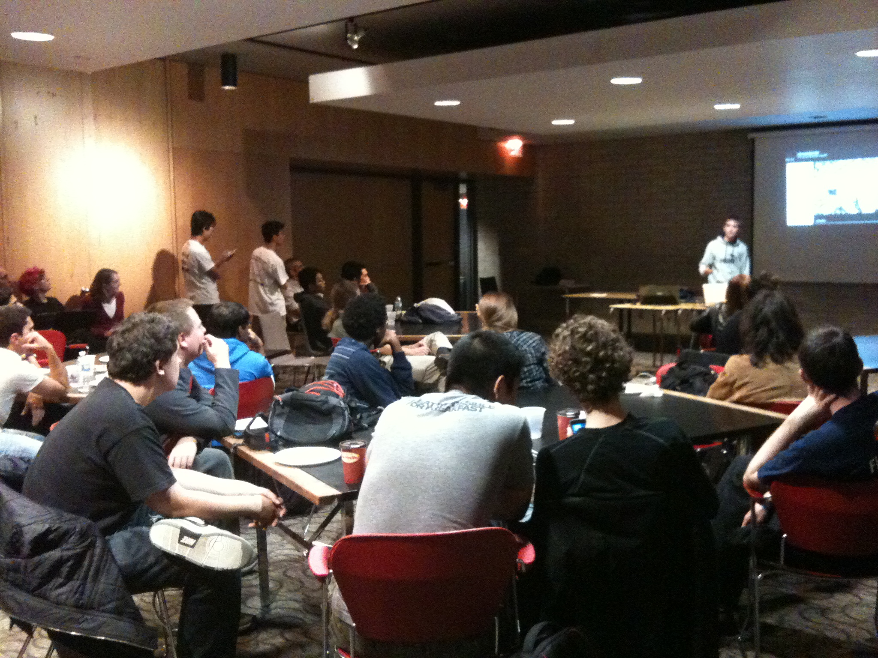
IRL Community with
DemoCamps
Notes:
Full room of 51 staff and students came to watch the demos and talk about open data.
9 demos presented, 8 of which were student-created projects.
Connected ~14 new people to the Open Data mailing list & ~8 new people to the SDN mailing list. * Significant VeloCity turnout: 2 demos were VeloCity coding weekend projects; ~10 members of VeloCity were in attendance; Expressed great interest to participate in "building apps fast" with University data. * Collaboration with the Computer Science Club: Approached by the CSC Librarian to plan a Coding Party to work on the Open Data API/SDN project(s). * Spreading the story: An Imprint author was in attendance and are meeting with Giles to write a story that will loop in the broader student body about student development. * We were able to connect like-minded students in a way that fostered creative, energetic discussion about what's next in student development at University of Waterloo.

Slide 29
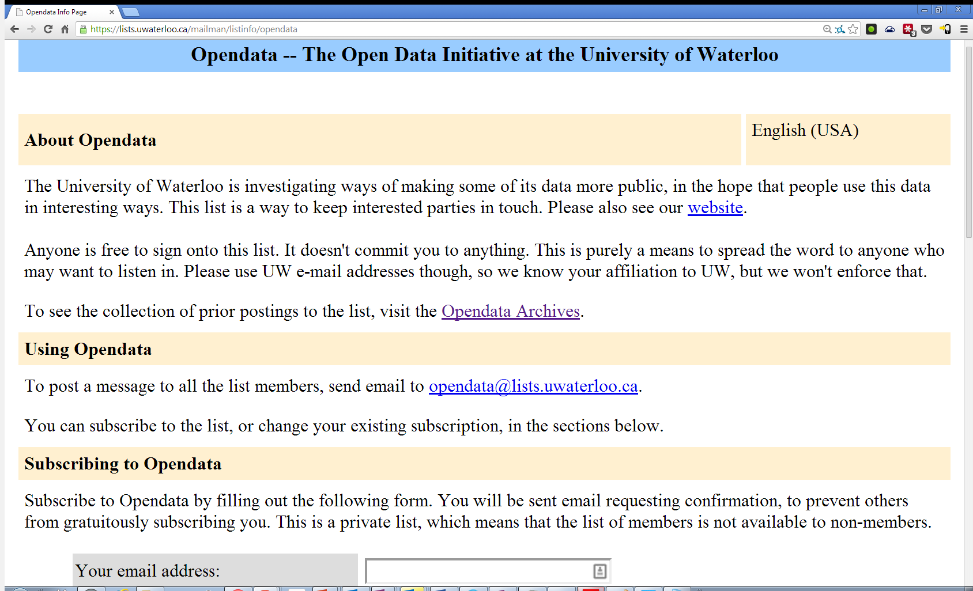
Stay in the loop with our
Mailing List
bit.ly/oduw_ml
Notes:
http://lists.uwaterloo.ca/pipermail/opendata/2011-October/000080.html

Slide 30
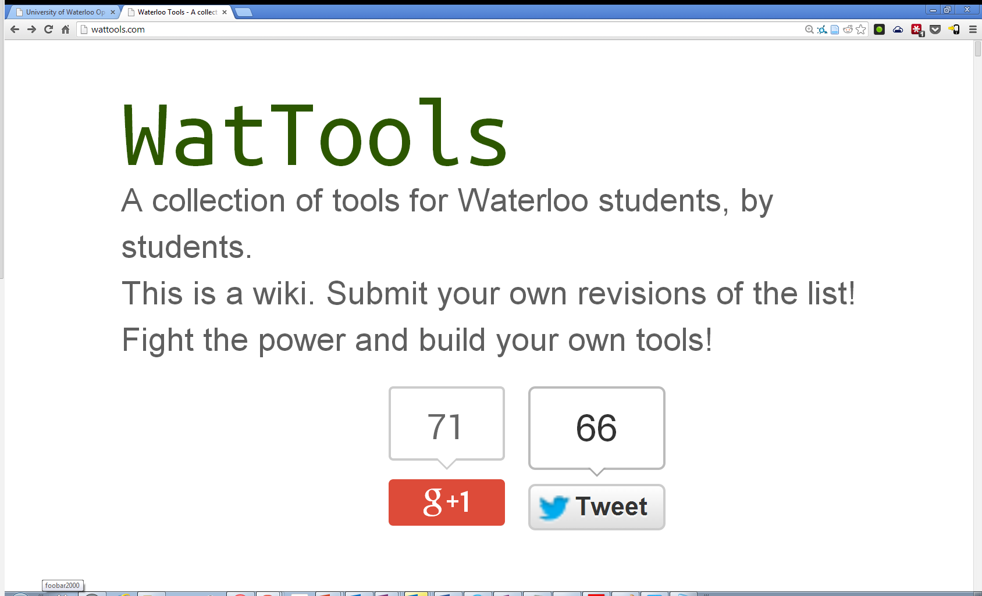
Community Created Tools
uwaterloo.xyz

Slide 31
Applied Example: Responding to Community Need
GOOSE WATCH
BACK to April 9, 2013

Slide 32

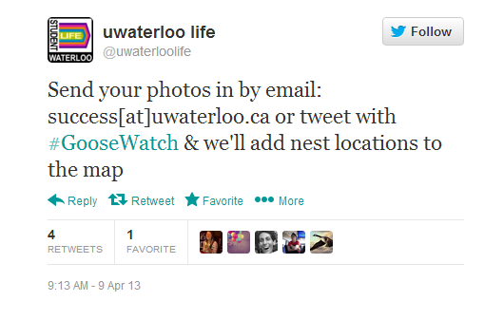
The Student Success Office Swings in Action to protect Students
Three Days PRIOR Sketch/Prototype
Three Days PRIOR Appeal For Data

Slide 33
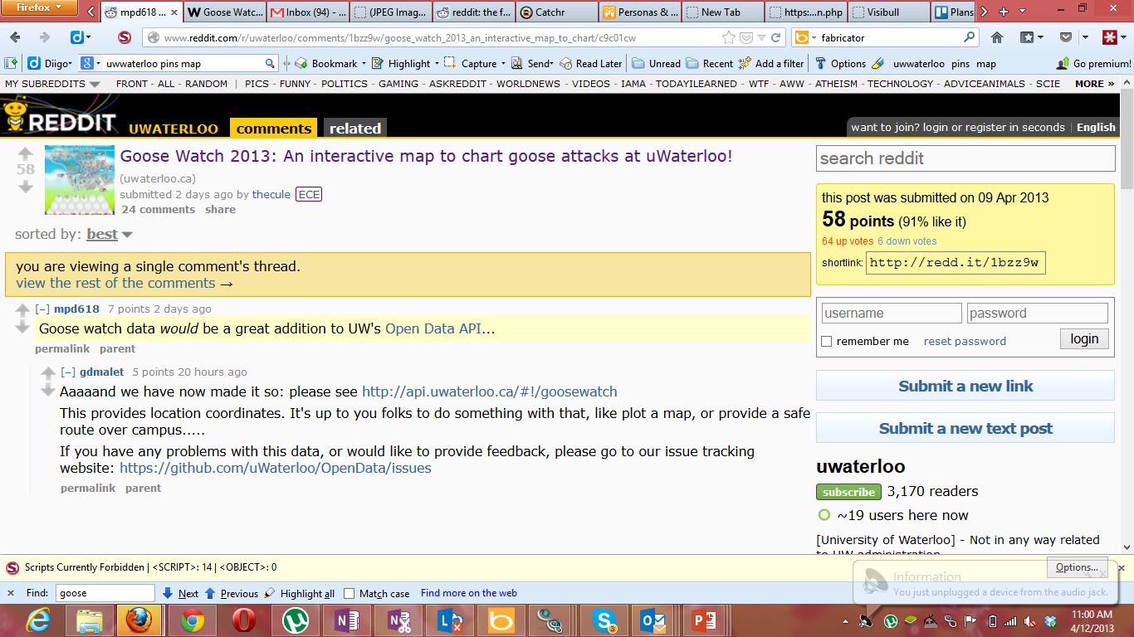
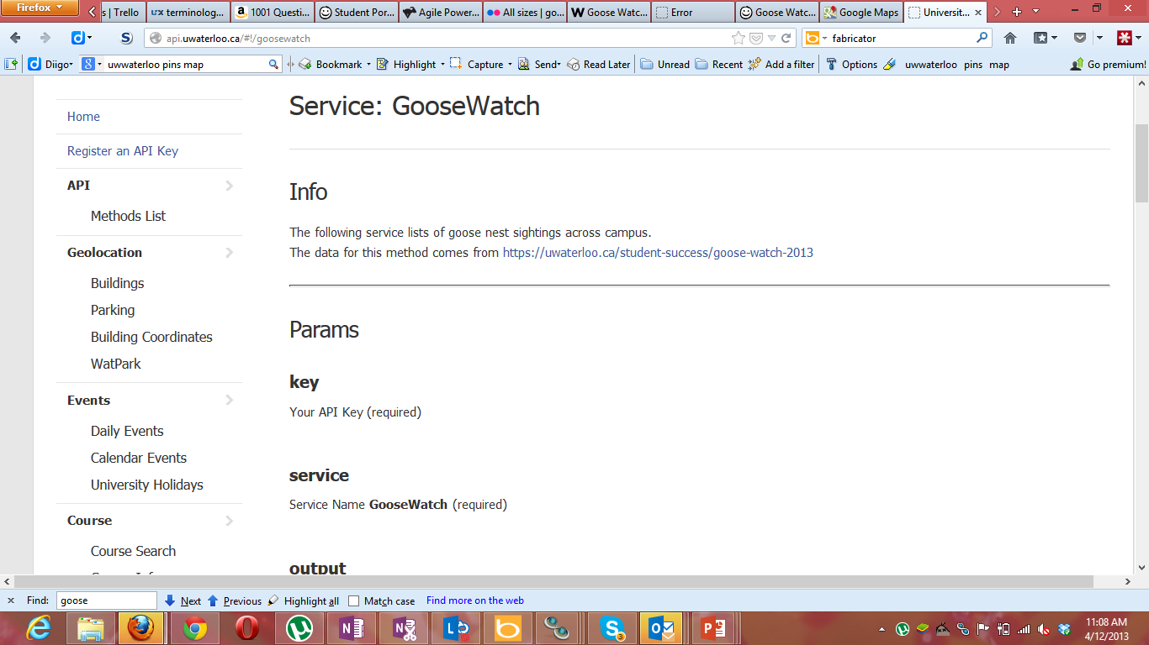
The UWaterloo Community Swings into Action to Request/Deliver Data
Two Days PRIOR The reddit Data Request
Mid Afternoon the Day Before The endpoint launches

Slide 34
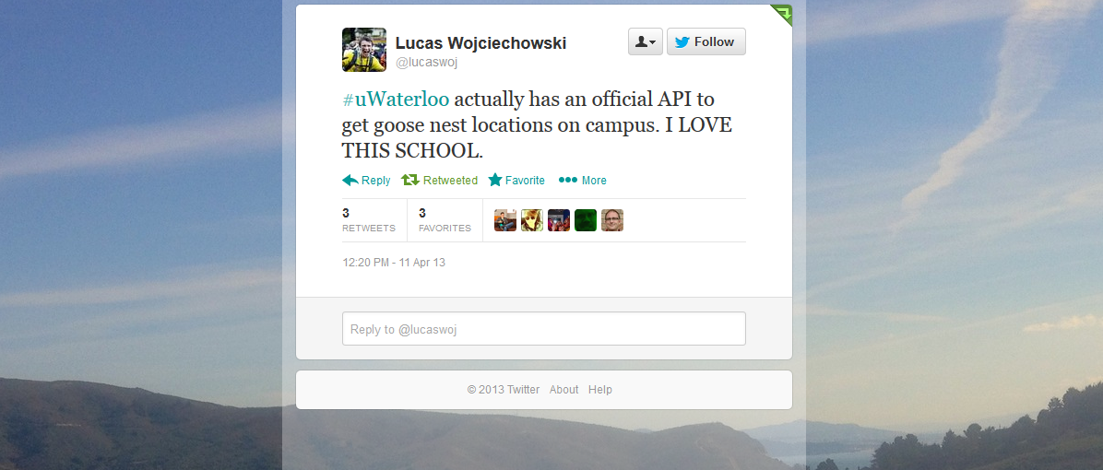
The Response

Slide 35
Progress!
API
PNG
5stardata.info

Slide 36
Technical Specifics

Slide 37
Datasets
Food Services
News and Events
CO-OP
WATpark
New Campus Map
Services
Awards
Tutors

Slide 38
Food Services
Locations and Hours
Daily menu
Nutritional Information
Notes:
Locations
https://uwaterloo.ca/food-services/content/revelation-ron-eydt-village
https://uwaterloo.ca/food-services/node/143/edit
https://uwaterloo.ca/food-services/locations-and-hours
https://api.uwaterloo.ca/v2/foodservices/locations.json?key=dem0hash
https://github.com/uWaterloo/api-documentation/blob/master/v2/foodservices/locations.md
http://env-apps.uwaterloo.ca/campus-map-demo/leaflet.html# | POI | Places | Food Services
https://uwportal.uwaterloo.ca/Index#/Home/FoodServices
Menu
Input Data: https://uwaterloo.ca/food-services/weekly-menu
Serve Data: http://api.uwaterloo.ca/v2/foodservices/menu.json?key=dem0hash
Document Serving of Data: https://github.com/uWaterloo/api-documentation/blob/master/v2/foodservices/menu.md

Slide 39
CO-OP Data
Employer Info-Sessions
Career Centre Workshops

Slide 40
Tutors
Find a Tutor for a course
See their availability and get help

Slide 41
WATPark
See live parking lot capacity
Get updates on opening and closing hours
Notes:
http://watpark.ca/home/
http://api.uwaterloo.ca/public/v1/?service=watpark&key=dem0hash
http://api.uwaterloo.ca/docs/v1/#!/watpark
http://env-apps.uwaterloo.ca/campus-map-demo/leaflet.html# | click on Parking | Visitor Parking
E.g. http://i.imgur.com/b7pEvnX.png
https://uwportal.uwaterloo.ca/Index#/Home/Parking

Slide 42
Github
Students Contributing Data
Students submitting datasets
Notes:
https://github.com/uWaterloo/Datasets
https://github.com/uWaterloo/Datasets/tree/master/Salaries

Slide 43
New Campus Map

Slide 44
Current State: Data Acquisition
Scrapers
Github
Crowdsourced
Maintained
CMS (Drupal)
Proxy requests
Pub/sub
Other Proxy Requests
Direct Database Integrations

Slide 45
Future State: Data Acquisition
Scrapers
Github
Crowdsourced
Maintained
CMS (Drupal)
Proxy requests
Pub/sub
Other Proxy Requests
Direct Database Integrations
Warehousing
ESB / iPaaS

Slide 46
Current State: Datasets
Food Services
DB
News/Events/etc
Pub Sub
CO-OP
WATpark
Proxy
New Campus Map
Curated GH
Tutors
Proxy
Awards
Proxy
Notes:
News/Events/Blogs

Slide 47
Technical Architecture
Student initiated, no fancy ($) tech involved.
After a number of iterative improvements, this is our stack.

Slide 48
api.uwaterloo.ca
App Server 1
App Server 2
Incoming Webhooks
Other Databases
API DB
Workers
Proxy Services

Slide 49
App Server
Incoming Webhooks
Proxy Services
Workers
New posts from university websites
Live requests from other internal APIs
Github sync, scrapers, updaters
API DB
Other DBs

Slide 50
App Server
API Request Router (PHP Klein)
Crons
Tutoring Services
Food Services
Campus Events
GET METHOD 1
GET METHOD 2
GET METHOD 3
Proxied via internal tutoring API
GET METHOD 1
GET METHOD 2
GET METHOD 3
Serve from FS DB
GET
Serve from DB
POST (webhook)
Process and
update DB
- sync datasets
- run scrapers
- cache things
Keep data on file system
Tutoring API
(other department)
FS DB
API DB

Slide 51
Documentation / Issue Tracking
Docs: Github w/ Markdown generator
Issue Tracking
Community Issues: Github
Service Desk: RT
Internal: Gitlab/Jira

Slide 52
Growing API Capability

Slide 53
Governance and Policy
Administrative Information Governance Committee (AIGC)
Vice Presidents, Senior Management, and Associate Provosts
2015 decision to consolidate IM related Policies.
Procedures and Guidelines to follow Policy. Draft of Policy being moved through review now.

Slide 54
Private Data
We have few private data APIs on campus. Faculty developed advising system provides student information backbone.
They are starting to grow. Principle established prioritizing API integration pathways.
Real uptake depends on Identity and Access Management implementations.
Shibboleth, SAML, OAUTH2 to come 2016/2017.

Slide 55
Business Process
Working to change the relationships.
Initially we leaned on AbD, many units felt ’bad things’ were happening.
Proven that the sky has not fallen.
Developing a Steering Committee model to help direct future development merging community needs with institutional goals.
Develop SLA with Information Stewards.

Slide 56
Data Warehousing / Enterprise Service Bus / iPaaS
Integrations on campus have been file or DB based. Times have changed, we are starting to change.
Open Data has provided us with knowledge and expertise in APIs.
As warehousing improves and we bring either an ESB or iPaaS solution on campus, our data architecture will start to take shape.

Slide 57
Data Warehousing / Enterprise Service Bus / iPaaS
SIS
HR
Data Warehousing
AbD
(Open)
Finance
API
Co-Op
PbD
(Priv)
Integration Engine (ESB/iPaaS)
…
OR

Slide 58
Future Directions
Composable Microservices
Create Once, Publish Everywhere (COPE) - NPR Model

Slide 59
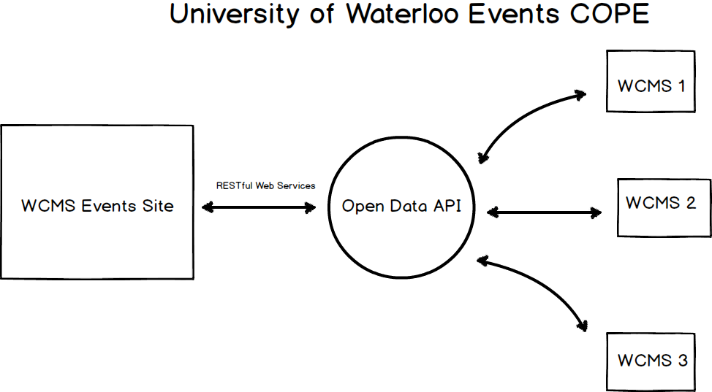
News and Events
University of Waterloo WCMS Create Once Publish Everyone COPE Strategy (Andrew McAlorum)
Notes:
Events
Create Content: https://uwaterloo.ca/canary/node/add/uw-event
Publish to Endpoint: https://uwaterloo.ca/canary/api/v1/events/all_events.json?api-key=96ab9383e6ad48c23aa1504dc9cc5c52
Proxy via a consistent endpoint (aggregated): http://api.uwaterloo.ca/v2/events.json?key=dem0hash
https://uwportal.uwaterloo.ca/Index#/Home/News
Syndication on other Drupal Sites

Slide 60
Growing Areas Of Service
Student Engagement (Portal)
Core IT Service (CMS + more)
Emerging Academic Use
For Students by Students
Open Data API
Campus Map
Research

Slide 61
The Open Data Engine
(Demand-First)
(Supply-First)
Services
News Events
Awards
Exam Schedule
CO-OP workshops
Tutors
Food Services
Publication
Notes:
Aggregators are force multipliers because they are a form of 5 star data

Slide 62
Questions?
api.uwaterloo.ca
cpbell@uwaterloo.ca
ztseguin@uwaterloo.ca
nvexler@uwaterloo.ca
ktalwar@uwaterloo.ca
Buy vs. Build?
How to build today?
How do you Document?
How to mitigate ERP culture clash?
Notes:
Seeded:
Buy vs. Build?
How to build today?
Start with Open Data to get started.
Lean on IPC AbD.
Stick with microframeworks, build light and build quick. Fail early and learn often.
Documentation ->
RAML and Swagger, etc.
ERP culture clash
Data Governance…

